Slide 1


Door Opening Warning Sensor
Illinois Institute of Technology
School of Applied Technology
ITM – 498
Gabriel Filipe Botelho Barbosa
Guilherme de Castro
Luiz Gustavo de Marchi Brito
Matheus Braz Duque
Rodrigo Ferreira Abdulmassih
Summer 2016
Notes:
Rodrigo and others -> everyone shall say their respective names.

Slide 2

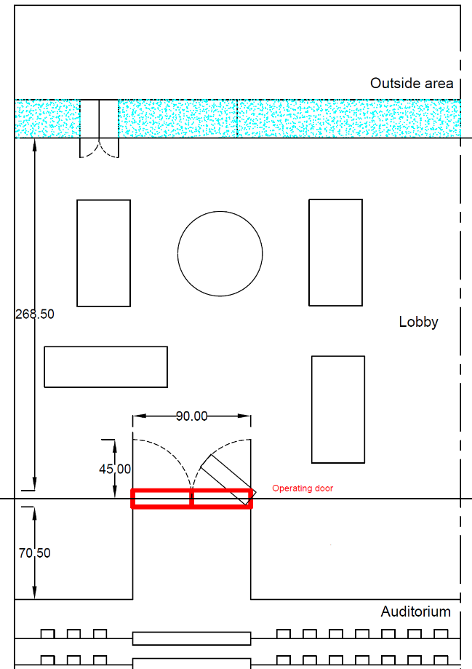
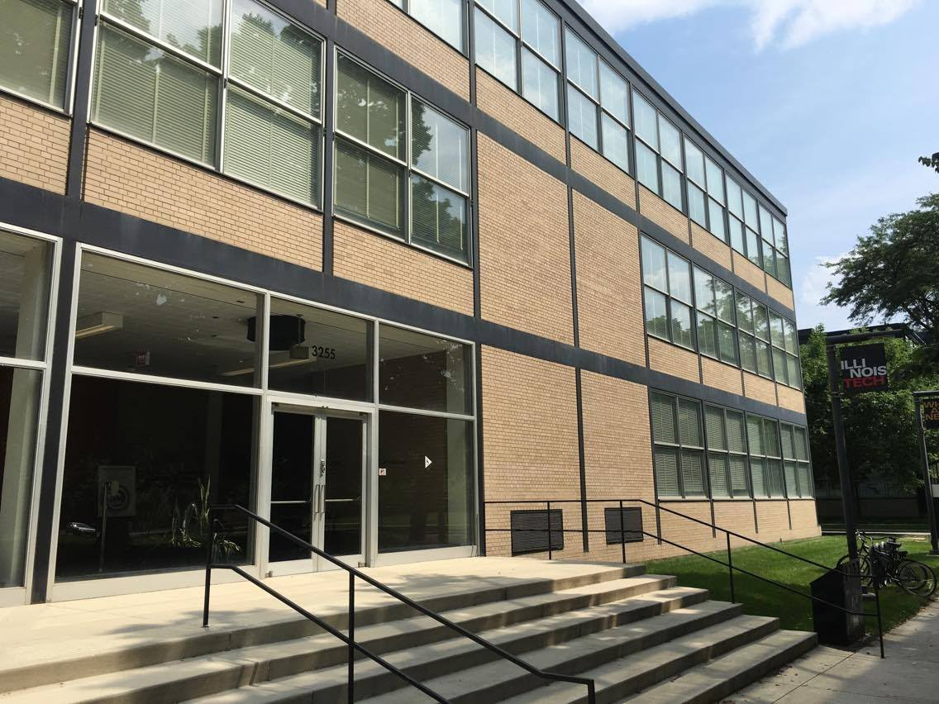
Introduction
Wishnick Hall, built in 1945, hosts many events. It counts with five classrooms and one auditorium.
Wishnick Hall – IIT Campus.
Summer 2016
Auditorium sketch – CAD 2016.
Notes:
Rodrigo

Slide 3

Introduction
Summer 2016
Notes:
Rodrigo

Slide 4
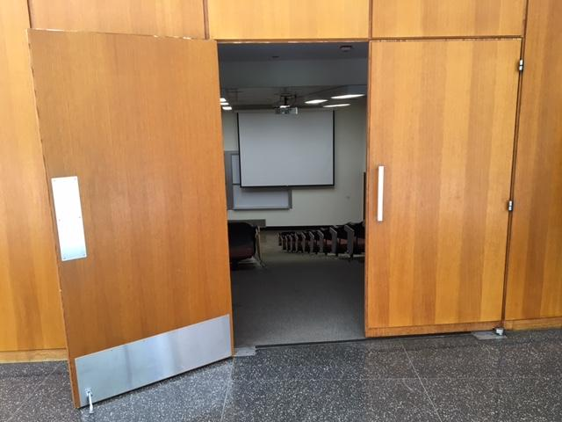
Proposal
In order to solve this issue, we were proposed to implement a warning sensor inside the auditorium, powered by a solar panel and a backup battery. This device would detect people approaching the door from inside and warn people outside, reducing impact risks similar to the video presented.
Operating door – Wishnick Hall.
Summer 2016
Notes:
Rodrigo

Slide 5
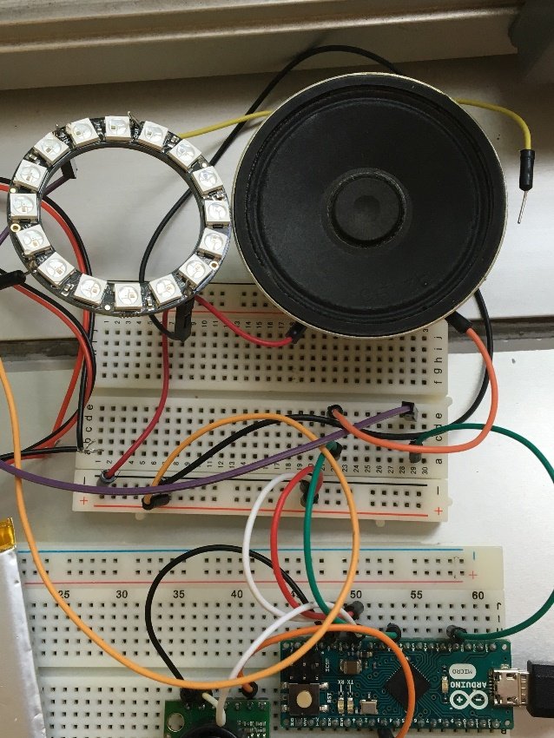
Warning Sensor: development
The warning system is visual and audible, so even people with certain disabilities will be able to use its functionalities.
Audible and visual warning system.
Summer 2016
Notes:
Matheus

Slide 6

Warning Sensor: Power Source
In order to achieve the community needs for environmentally friendly systems, the whole warning device will be powered by a solar panel. Additionally, it will have a battery for backup.
Medium 6V 2W Solar panel – 2.0 Watt
Summer 2016
Notes:
Matheus

Slide 7
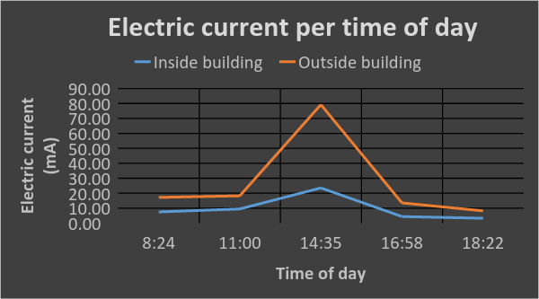
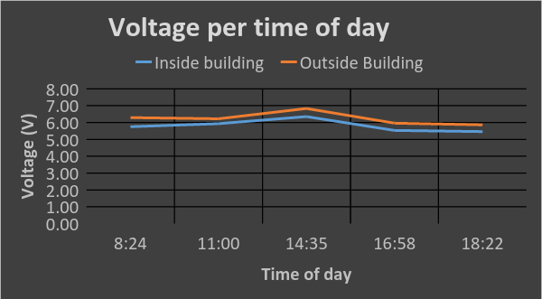
Warning Sensor: Power Source
It is certain that the glass, specifically the one used in the mentioned building, influences the solar panel efficiency on its duty to provide the necessary energy to the warning device. An experiment was performed and the results show that inside the building, the solar panel provides about 30% of the power if compared to the outdoor set up.
Summer 2016
Notes:
Matheus

Slide 8
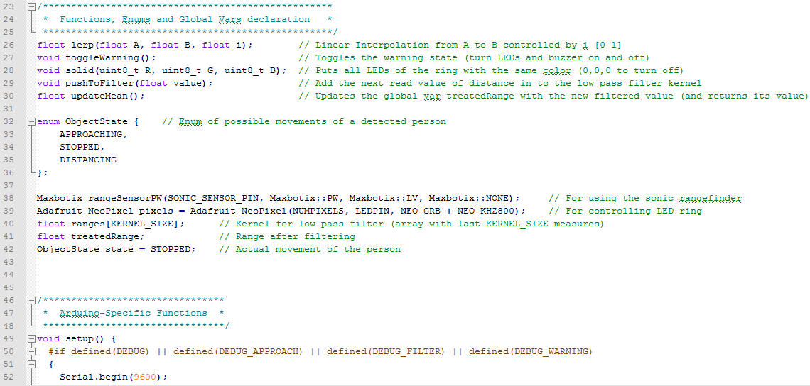
Warning Sensor: Sensor Code
The sensor code was based on the language C++. It runs on an Arduino micro, which is a microcontroller capable to process data and operate electronic devices, such as LEDs and buzzers.
Screenshot of code?
Piece of the code implemented
Summer 2016
Notes:
Gabriel

Slide 9
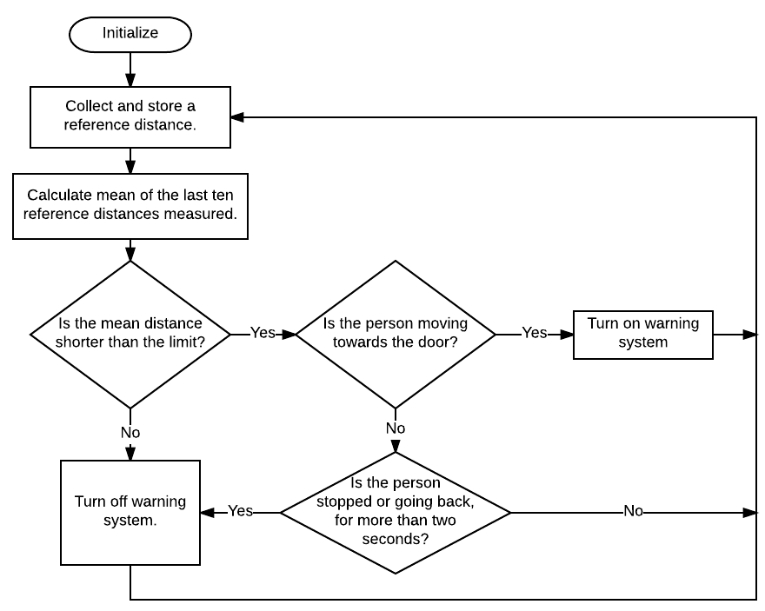
Warning Sensor: Sensor Algorithm
Algorithm’s fluxogram
Summer 2016
Notes:
Gabriel

Slide 10
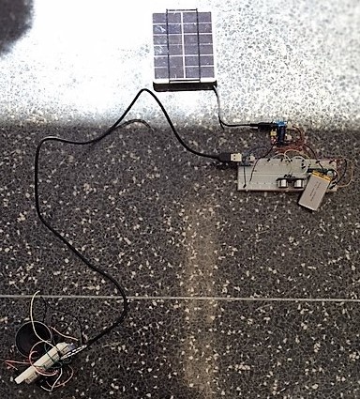
Warning Sensor: Testing
The whole system was tested under these conditions:
Using a variable power source, set for 6V;
Using solar panel;
Using backup battery.
Summer 2016
Warning sensor testing apparatus.
Notes:
Gabriel

Slide 11
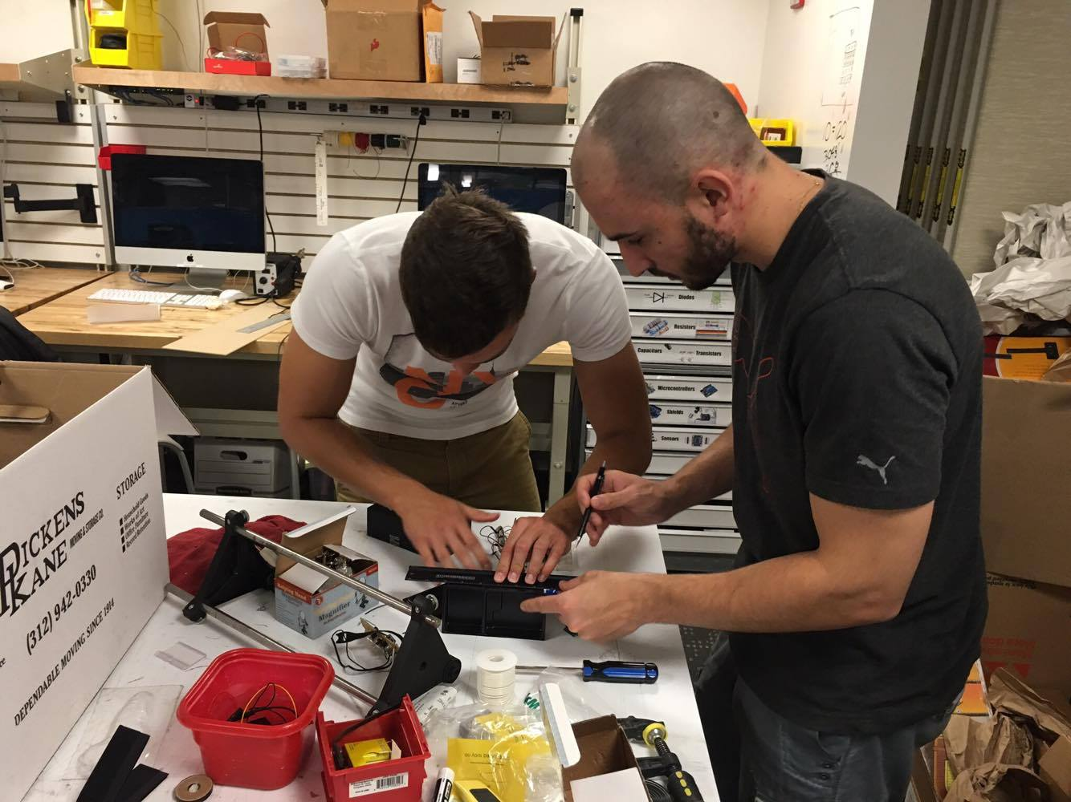
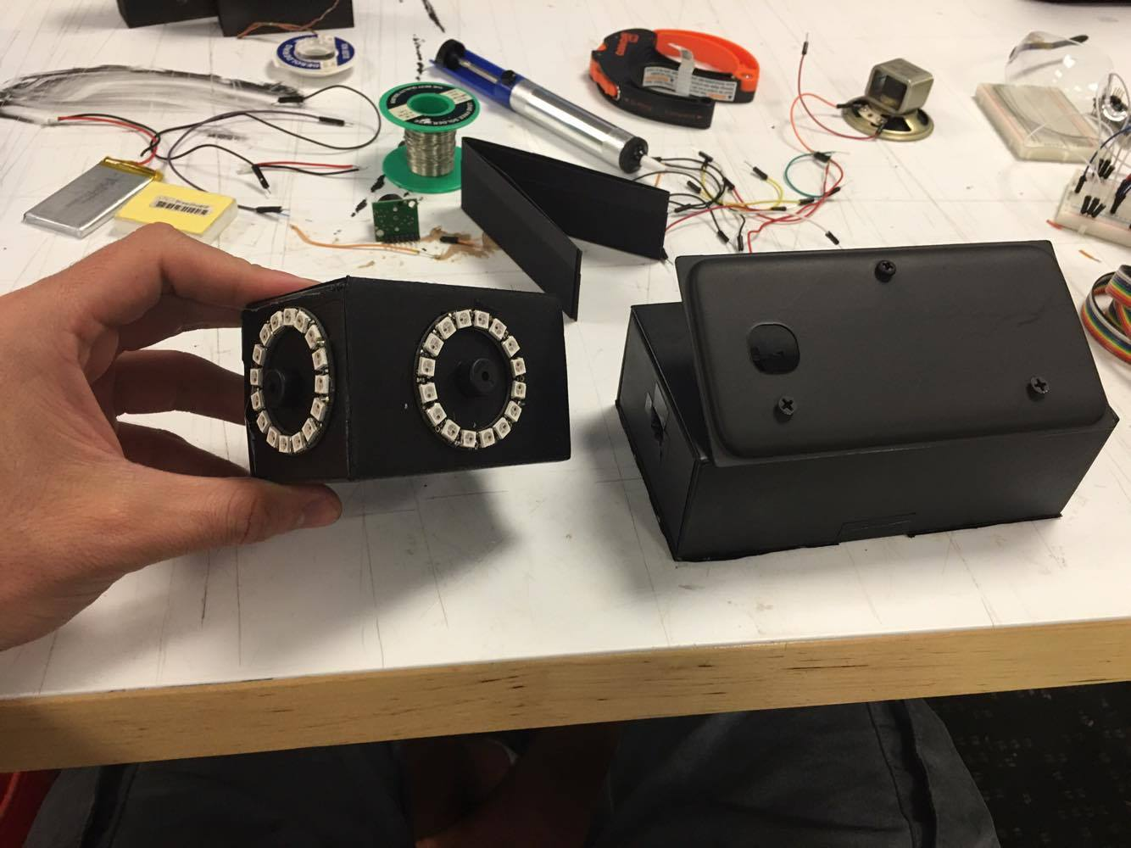
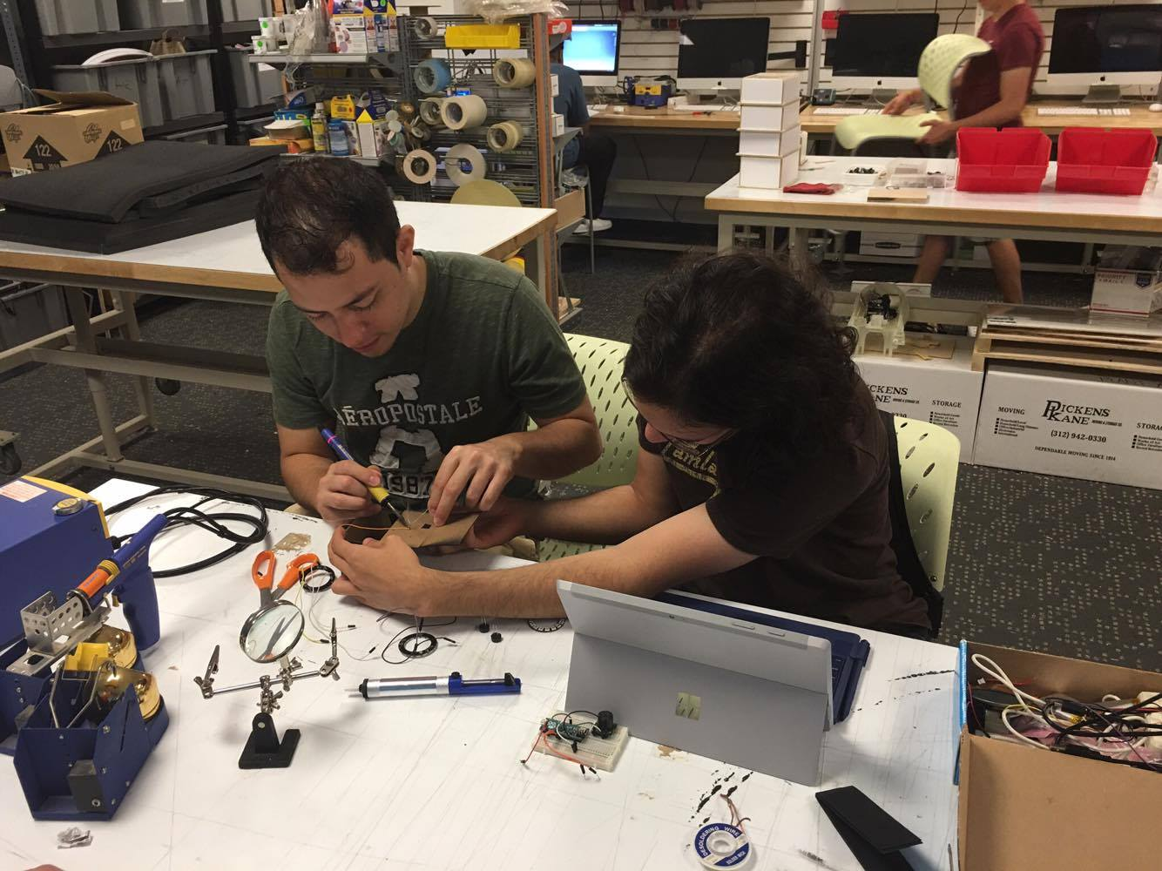
Warning Sensor: Prototype
In order to develop a more user-friendly model,
two cases were modified in order to suit both the
warning devices and microcontroller.
Case modifications at IDEA Shop,
IIT Campus.
Final prototype cases.
Summer 2016
Notes:
Rodrigo

Slide 12
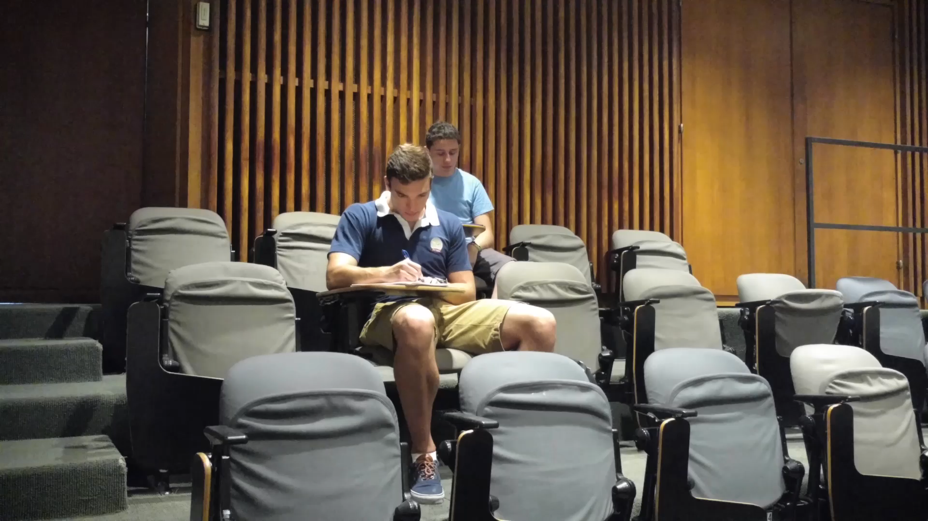
Warning Sensor: Final Result
Summer 2016
Notes:
Rodrigo

Slide 13
Conclusion and optimization
The prototype achieved its previous stated objectives and enhanced the safety matter at Wishnick Hall.
As every project, some optimizations can be done, such as:
Replace sensor for image processing;
Design permanent case and installation, with luminous “EXIT” signs, for mass production;
Design a more compact Printed Circuit Board (PCB);
Change in power source depending on location.
Summer 2016
Notes:
Matheus

